Slide 1

CSE 470/598 Open GL Shading Language
Ross Maciejewski
rmacieje@asu.edu

Slide 2
Disclaimer
These slides can only be used as study material for the class 470 at ASU
The slides cannot be distributed or used for another purpose

Slide 3
Enabling Shading
Shading calculations are enabled by
glEnable(GL_LIGHTING)
Once lighting is enabled, glColor() ignored
(Can still use GL_COLOR_MATERIAL…)
Must enable each light source individually
glEnable(GL_LIGHTi) i=0,1…..
Can choose light model parameters
glLightModeli(parameter, GL_TRUE)
GL_LIGHT_MODEL_LOCAL_VIEWER do not use simplifying distant viewer assumption in calculation
GL_LIGHT_MODEL_TWO_SIDED shades both sides of polygons independently

Slide 4
What is a “shader”?
Shaders are simple code that describe traits of either vertex or pixels
Vertex shaders are run once for each vertex given to the graphics process
They describe the traits (position, texture coordinates, color, etc.) of a vertex
Pixel shaders describe (color, z-depth and alpha, etc.) of a pixel.
Pixel shaders are also known as fragment shaders (Direct3D uses the term pixel shader, OpenGL says Fragment Shader)
OpenGL provides a C-like shader language called OpenGL Shading Language

Slide 5
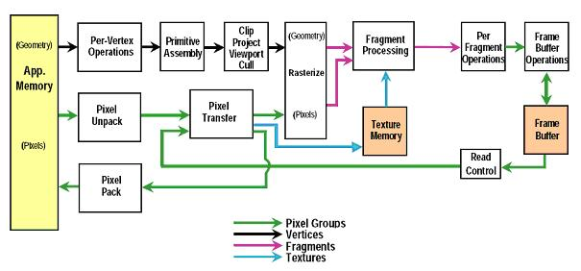

Slide 6
Vertex Shader Applications
Moving vertices
Morphing
Wave motion
Fractals
Lighting
More realistic models
Cartoon shaders

Slide 7
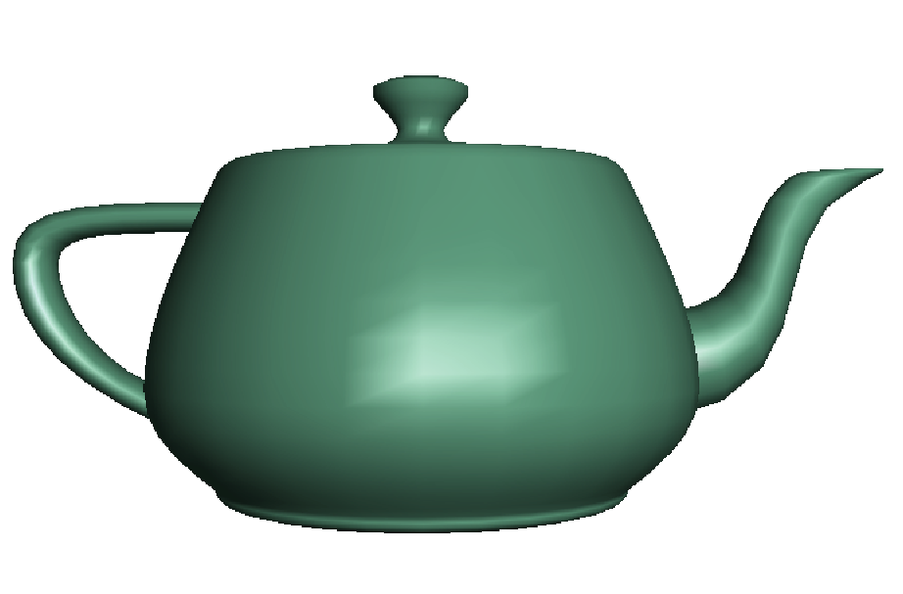
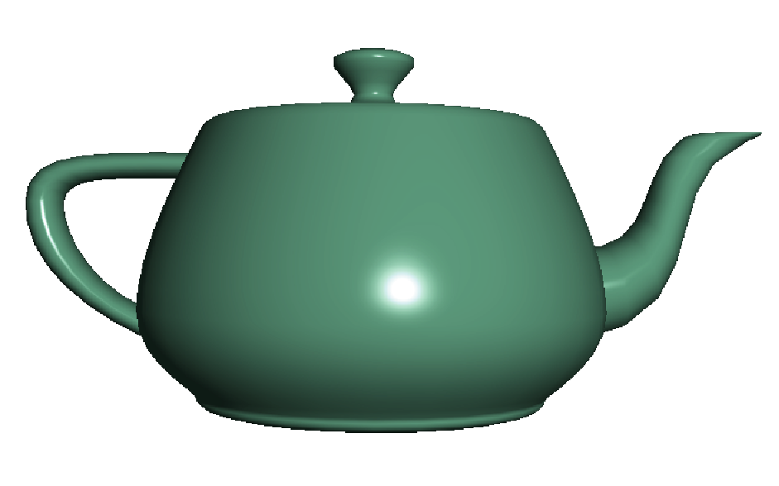
Fragment Shader Applications
Per fragment lighting calculations
per vertex lighting
per fragment lighting

Slide 8
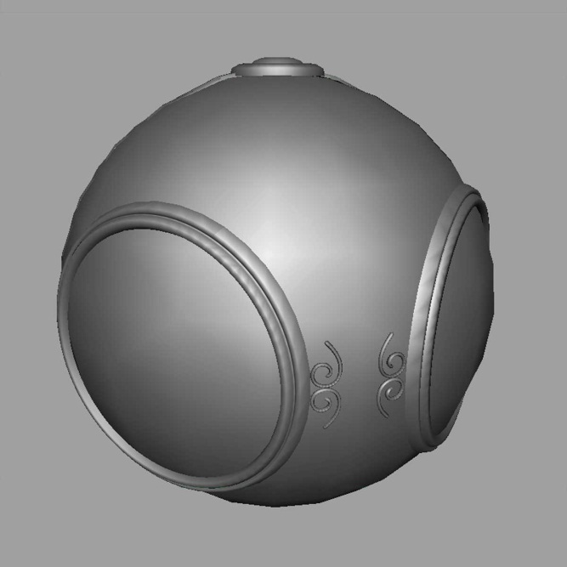

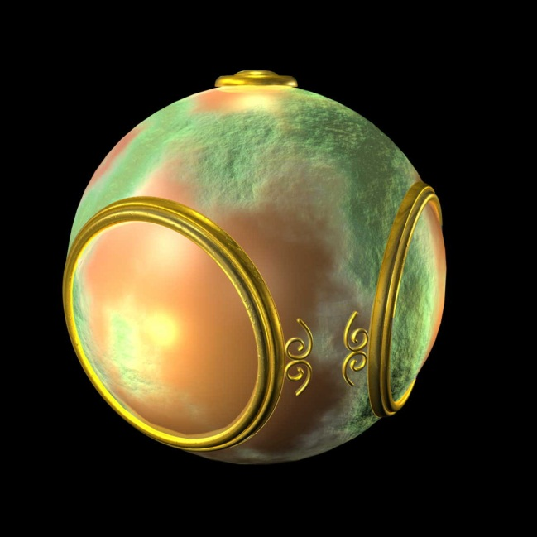
Fragment Shader Applications
Texture mapping
smooth shading
environment
mapping
bump mapping

Slide 9
Writing Shaders
First programmable shaders were programmed in an assembly-like manner
OpenGL extensions added for vertex and fragment shaders
Cg (C for graphics) C-like language for programming shaders
Works with both OpenGL and DirectX
Interface to OpenGL complex
OpenGL Shading Language (GLSL)

Slide 10
GLSL
OpenGL Shading Language
Part of OpenGL 2.0 and up
High level C-like language
New data types
Matrices
Vectors
Samplers
As of OpenGL 3.1, application must provide shaders

Slide 11
Data Types in GLSL
Four main types: float, int, bool and sampler
For first three types, vector types are available
Vec2, vec3, vec4 (2D, 3D and 4D floating point vector)
ivec2, ivec3, ivec4 (integer vector)
bvec2, bvec3, bvec4 (boolean vector)
For floats, there are also matrix types
mat2, mat3, mat4
Samplers are types representing texture
Must be uniform
sampler1D, sampler2D, sampler3D (1D, 2D and 3D texture)
samplerCube (Cube Map txture)
sampler1Dshadow, sampler2Dshadow (1D and 2D depth-component texture)

Slide 12
Attributes
Three types of inputs and outputs in a share
Uniforms
Values which do not change during rendering (read-only)
Attributes
Only available in vertex shader and they are input values which change for every vertex
Varying
Used for passing data from a vertex shader to a fragment shader

Slide 13
Built-In Types
There are some built-in attributes for vertex shader
gl-_Vertex, gl_Normal, glColor, gl_MultiTexCoordx
Built-in uniforms
gl_ModelViewMatrix, gl_ModelViewProjectionMatrix, glNormalMatrix
Built-in varyings
gl_FrontColor, gl_BackColor, gl_TexCoord

Slide 14
Simple Vertex Shader
input from application
in vec4 vPosition;
void main(void)
{
gl_Position = vPosition;
}
must link to variable in application
built in variable

Slide 15
Execution Model
Vertex data
Shader Program
GPU
Application
Program
Vertex
Shader
Primitive
Assembly
glDrawArrays
Vertex

Slide 16
Simple Fragment Program
void main(void)
{
gl_FragColor = vec4(1.0, 0.0, 0.0, 1.0);
}

Slide 17
Execution Model
Application
Shader Program
Rasterizer
Fragment
Shader
Frame Buffer
Fragment
Fragment
Color

Slide 18
Data Types
C types: int, float, bool
Vectors:
float vec2, vec3, vec4
Also int (ivec) and boolean (bvec)
Matrices: mat2, mat3, mat4
Stored by columns
Standard referencing m[row][column]
C++ style constructors
vec3 a =vec3(1.0, 2.0, 3.0)
vec2 b = vec2(a)

Slide 19
Pointers
There are no pointers in GLSL
We can use C structs which
can be copied back from functions
Because matrices and vectors are basic types they can be passed into and output from GLSL functions, e.g.
mat3 func(mat3 a)

Slide 20
Qualifiers
GLSL has many of the same qualifiers such as const as C/C++
Need others due to the nature of the execution model
Variables can change
Once per primitive
Once per vertex
Once per fragment
At any time in the application
Vertex attributes are interpolated by the rasterizer into fragment attributes

Slide 21
Attribute Qualifier
Attribute-qualified variables can change at most once per vertex
There are a few built in variables such as gl_Position but most have been deprecated
User defined (in application program)
Use in qualifier to get to shader
in float temperature
in vec3 velocity

Slide 22
Uniform Qualified
Variables that are constant for an entire primitive
Can be changed in application and sent to shaders
Cannot be changed in shader
Used to pass information to shader such as the bounding box of a primitive

Slide 23
Varying Qualified
Variables that are passed from vertex shader to fragment shader
Automatically interpolated by the rasterizer
Old style used the varying qualifier
varying vec4 color;
Now use out in vertex shader and in in the fragment shader
out vec4 color;

Slide 24
Example: Vertex Shader
const vec4 red = vec4(1.0, 0.0, 0.0, 1.0);
out vec3 color_out;
void main(void)
{
gl_Position = vPosition;
color_out = red;
}

Slide 25
Required Fragment Shader
in vec3 color_out;
void main(void)
{
gl_FragColor = color_out;
}
// in latest version use form
// out vec4 fragcolor;
// fragcolor = color_out;

Slide 26
Passing values
call by value-return
Variables are copied in
Returned values are copied back
Three possibilities
in
out
inout (deprecated)

Slide 27
Operators and Functions
Standard C functions
Trigonometric
Arithmetic
Normalize, reflect, length
Overloading of vector and matrix types
mat4 a;
vec4 b, c, d;
c = b*a; // a column vector stored as a 1d array
d = a*b; // a row vector stored as a 1d array

Slide 28
Swizzling and Selection
Can refer to array elements by element using [] or selection (.) operator with
x, y, z, w
r, g, b, a
s, t, p, q
a[2], a.b, a.z, a.p are the same
Swizzling operator lets us manipulate components
vec4 a;
a.yz = vec2(1.0, 2.0);

Slide 29
Objectives
Coupling shaders to applications
Reading
Compiling
Linking
Vertex Attributes
Setting up uniform variables
Example applications

Slide 30
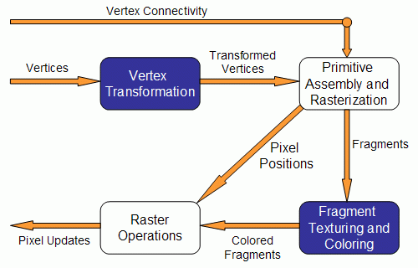

Slide 31
Vertex Transformation
Vertex position transformation
Lighting computations per vertex
Generation and transformation of texture coordinates

Slide 32
Primitive Assembly and Rasterization
Inputs for this stage are the transformed vertices as well as the connectivity information
This stage is responsible for clipping operations against the view frustum and back face culling
Rasterization determines the fragments and pixel positions of a primitive
A fragment is a piece of data that will be used to update a pixel in the frame buffer at a specific location
Fragments contain not only colors, but also normals and texture coordinates
The output of this stage is the position of the fragments in the frame buffer and the interpolated values for each fragment

Slide 34
Fragment Texturing and Coloring
Interpolated fragment information is output in this stage
Color has been computed through interpolation in the previous stage and it can be combined with a texel here.
Fog is also applied at this stage

Slide 35
Raster Operations
Performs a series of tests
Scissor test
OpenGL scissor test is used to restrict drawing to a certain part of the window
Alpha Test
Discards a fragment conditional on the outcome of a comparison between the incoming fragment’s alpha value and a constant
Stencil Test
comparison between the value in the stencil buffer for the fragment's destination pixel and the stencil reference value
Depth Test
The depth buffer test discards the incoming fragment if a depth comparison fails

Slide 36
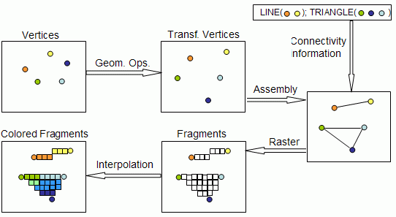
Raster Operations
If successful tests occur, then the fragment information is used to update the pixel’s value
This is the only stage in which the frame buffer is accesible

Slide 37
Vertex Processor
The vertex processor is responsible for running the vertex shaders
The input for a vertex shader is the vertex data, namely its position, color, normals, etc, depending on what the OpenGL application sends.
The following code would send the vertex processor a color and vertex position for each vertex
glBegin(...);
glColor3f(0.2,0.4,0.6);
glVertex3f(-1.0,1.0,2.0);
glColor3f(0.2,0.4,0.8);
glVertex3f(1.0,-1.0,2.0);
glEnd();

Slide 38
Vertex Shader
In a vertex shader you can write code for tasks such as:
Vertex position transformation using the modelview and projection matrices
Normal transformation, and if required its normalization
Texture coordinate generation and transformation
Lighting per vertex or computing values for lighting per pixel
Color computation
Once you write a vertex shader you are replacing the full functionality of the vertex processor

Slide 39
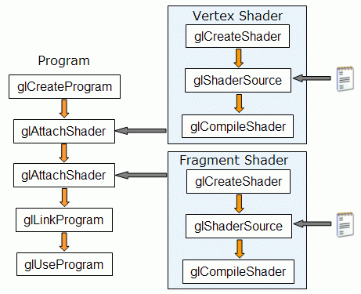
Steps to create shaders

Slide 40
Linking Shaders with Application
Read shaders
Compile shaders
Create a program object
Link everything together
Link variables in application with variables in shaders
Vertex attributes
Uniform variables

Slide 41
Program Object
Container for shaders
Can contain multiple shaders
Other GLSL functions
GLuint myProgObj;
myProgObj = glCreateProgram();
/* define shader objects here */
glUseProgram(myProgObj);
glLinkProgram(myProgObj);

Slide 42
Reading a Shader
Shaders are added to the program object and compiled
Usual method of passing a shader is as a null-terminated string using the function glShaderSource
If the shader is in a file, we can write a reader to convert the file to a string

Slide 43
Shader Reader
#include <stdio.h>
static char*
readShaderSource(const char* shaderFile)
{
FILE* fp = fopen(shaderFile, "r");
if ( fp == NULL ) { return NULL; }
fseek(fp, 0L, SEEK_END);
long size = ftell(fp);

Slide 44
Shader Reader (cont)
fseek(fp, 0L, SEEK_SET);
char* buf = new char[size + 1];
fread(buf, 1, size, fp);
buf[size] = '\0';
fclose(fp);
return buf;
}

Slide 45
glCreateShader
The first step is creating an object which will act as a shader container.
The function available for this purpose returns a handle for the container.
The OpenGL 2.0 syntax for this function is as follows:
GLuint glCreateShader(GLenum shaderType);
Parameter:
shaderType - GL_VERTEX_SHADER or GL_FRAGMENT_SHADER.
You can create as many shaders as you want to add to a program, but remember that there can only be a main function for the set of vertex shaders and one main function for the set of fragment shaders in each single program.

Slide 46
glShaderSource
void glShaderSource(GLuint shader, int numOfStrings, const char **strings, int *lenOfStrings);
Parameters:
shader - the handler to the shader
numOfStrings - the number of strings in the array
strings - the array of strings
lenOfStrings - an array with the length of each string, or NULL, meaning that the strings are NULL terminated.

Slide 47
Compiling the shader
void glCompileShader(GLuint shader);
Parameters:
shader - the handler to the shader.

Slide 48
Adding a Vertex Shader
GLuint vShader;
GLunit myVertexObj;
GLchar vShaderfile[] = “my_vertex_shader”;
GLchar* vSource =
readShaderSource(vShaderFile);
glShaderSource(myVertexObj,
1, &vertexShaderFile, NULL);
myVertexObj =
glCreateShader(GL_VERTEX_SHADER);
glCompileShader(myVertexObj);
glAttachObject(myProgObj, myVertexObj);

Slide 49
Vertex Attributes
Vertex attributes are named in the shaders
Linker forms a table
Application can get index from table and tie it to an application variable
Similar process for uniform variables

Slide 50
Vertex Attribute Example
#define BUFFER_OFFSET( offset )
((GLvoid*) (offset))
GLuint loc =
glGetAttribLocation( program, "vPosition" );
glEnableVertexAttribArray( loc );
glVertexAttribPointer( loc, 2, GL_FLOAT,
GL_FALSE, 0, BUFFER_OFFSET(0) );

Slide 51
Uniform Variable Example
GLint angleParam;
angleParam = glGetUniformLocation(myProgObj,
"angle");
/* angle defined in shader */
/* my_angle set in application */
GLfloat my_angle;
my_angle = 5.0 /* or some other value */
glUniform1f(angleParam, my_angle);

Slide 52
Attribute and Varying Qualifiers
Starting with GLSL 1.5 attribute and varying qualifiers have been replaced by in and out qualifiers
No changes needed in application
Vertex shader example:
#version 1.4
attribute vec3 vPosition;
varying vec3 color;
#version 1.5
in vec3 vPosition;
out vec3 color;

Slide 53
Adding Color
If we set a color in the application, we can send it to the shaders as a vertex attribute or as a uniform variable depending on how often it changes
Let’s associate a color with each vertex
Set up an array of same size as positions
Send to GPU as a vertex buffer object

Slide 54
Setting Colors
typedef vec3 color3;
color3 base_colors[4] = {color3(1.0, 0.0. 0.0), ….
color3 colors[NumVertices];
vec3 points[NumVertices];
//in loop setting positions
colors[i] = basecolors[color_index]
position[i] = …….

Slide 55
Setting Up Buffer Object
//need larger buffer
glBufferData(GL_ARRAY_BUFFER, sizeof(points) +
sizeof(colors), NULL, GL_STATIC_DRAW);
//load data separately
glBufferSubData(GL_ARRAY_BUFFER, 0,
sizeof(points), points);
glBufferSubData(GL_ARRAY_BUFFER, sizeof(points),
sizeof(colors), colors);

Slide 56
Second Vertex Array
// vPosition and vColor identifiers in vertex shader
loc = glGetAttribLocation(program, “vPosition”);
glEnableVertexAttribArray(loc);
glVertexAttribPointer(loc, 3, GL_FLOAT, GL_FALSE, 0,
BUFFER_OFFSET(0));
loc2 = glGetAttribLocation(program, “vColor”);
glEnableVertexAttribArray(loc2);
glVertexAttribPointer(loc2, 3, GL_FLOAT, GL_FALSE, 0,
BUFFER_OFFSET(sizeofpoints));

Slide 57
Vertex Shader Applications
Moving vertices
Morphing
Wave motion
Fractals
Lighting
More realistic models
Cartoon shaders

Slide 58
Wave Motion Vertex Shader
in vec4 vPosition;
uniform float xs, zs, // frequencies
uniform float h; // height scale
void main()
{
vec4 t = vPosition;
t.y = vPosition.y
+ h*sin(time + xs*vPosition.x)
+ h*sin(time + zs*vPosition.z);
gl_Position = t;
}

Slide 59
Particle System
in vec3 vPosition;
Uniform mat4 ModelViewProjectionMatrix;
uniform vec3 init_vel;
uniform float g, m, t;
void main()
{
vec3 object_pos;
object_pos.x = vPosition.x + vel.x*t;
object_pos.y = vPosition.y + vel.y*t
+ g/(2.0*m)*t*t;
object_pos.z = vPosition.z + vel.z*t;
gl_Position =
ModelViewProjectionMatrix*vec4(object_pos,1);
}

Slide 60
Pass Through Fragment Shader
/* pass-through fragment shader */
in vec4 color;
void main(void)
{
gl_FragColor = color;
}

